Slide 1
Drama

Slide 2
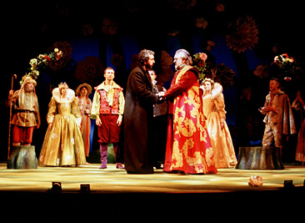
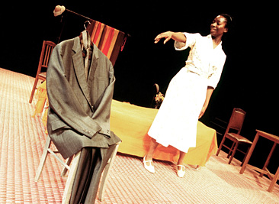
What Is Drama?
A drama is a story enacted onstage for a live audience.

Slide 3
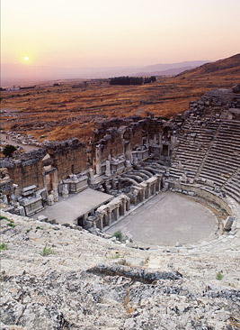
What Is Drama?
Origins of Drama
  The word drama comes from the Greek verb dran, which means “to do.”
    The earliest known plays . . .
      were written around the fifth century B.C.
      produced for festivals to honor Dionysus, the god of wine and fertility

Slide 4
Dramatic Structure
Like the plot of a story, the plot of a play involves characters who face a problem or conflict.
Climax
point of highest tension;
action determines how the conflict will be resolved
Complications
tension builds
Resolution
conflict is resolved;
play ends
Exposition
characters and conflict are introduced

Slide 5
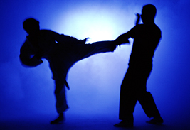
Dramatic Structure
Conflict is a struggle or clash between opposing characters or forces. A conflict may develop . . .
      between characters who want different things or the same thing
      between a character and his or her circumstances
      within a character who is torn by competing desires

Slide 6
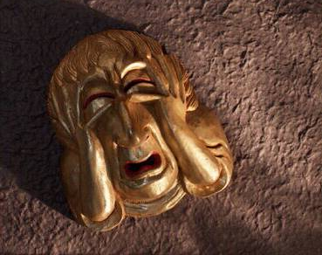
Tragedy
A tragedy is a play that ends unhappily.
  Most classic Greek tragedies deal with serious, universal themes such as
right and wrong
justice and injustice
life and death
Tragedies pit human limitations against the larger forces of destiny.

Slide 7
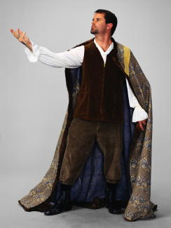
Tragedy
The protagonist of most classical tragedies is a tragic hero. This hero
pride
  is noble and in many ways admirable
  has a tragic flaw, a personal failing that leads to a tragic end
rebelliousness
jealousy

Slide 8

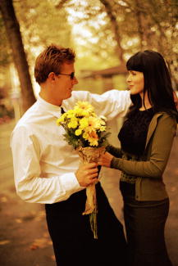
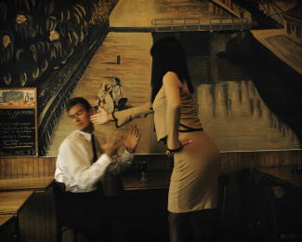
Comedy
A comedy is a play that ends happily. The plot usually centers on a romantic conflict.
boy meets girl
boy loses girl
boy wins girl

Slide 9
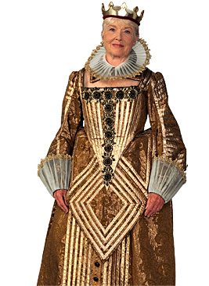
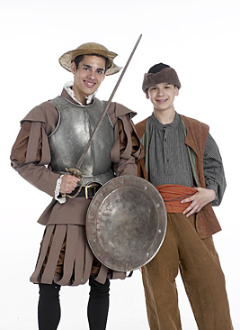
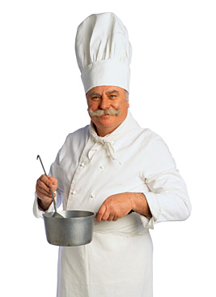
Comedy
The main characters in a comedy could be anyone:
nobility
townspeople
servants

Slide 10
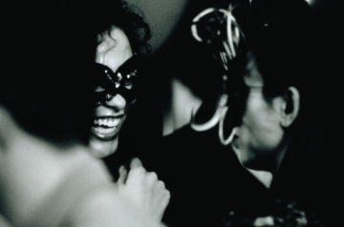
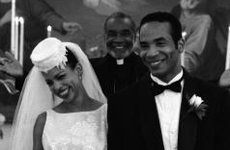
Comedy
  Comic complications always occur before the conflict is resolved.
  In most cases, the play ends with a wedding.

Slide 11
Modern Comedy
Modern Comedies
  In modern comedies, the genders in this romantic plot pattern sometimes are reversed.

Slide 12
Modern Drama
A modern play
  may be tragedy, comedy, or a mixture of the two
  usually focuses on personal issues
  usually is about ordinary people

Slide 13
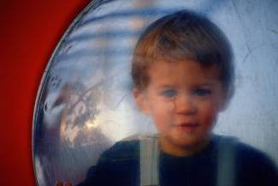
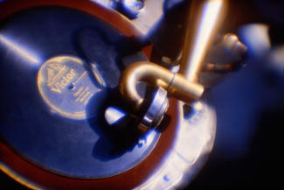

Modern Drama
Modern playwrights often experiment with unconventional plot structures.
long flashbacks
music
visual projections of a character’s private thoughts

Slide 14
Performance of a Play
When you read a play, remember that it is meant to be performed for an audience.
Stage Directions
Playwright describes setting and characters’ actions and manner.
[Wyona is sitting on the couch. She sees Paul and jumps to her feet.] Wyona. [Angrily.] What do you want?
Performance
Theater artists bring the playwright’s vision to life on the stage. The audience responds to the play and shares the experience.

Slide 15
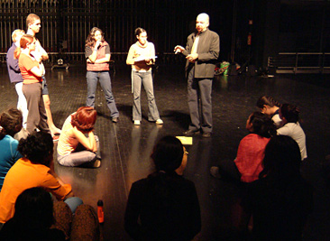
Performance of a Play
Theater artists include
  Actors
  Directors
  Lighting technicians
  Stage crew

Slide 16
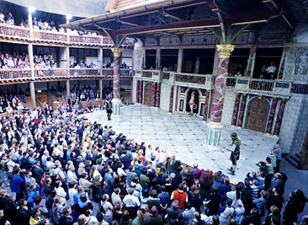
Setting the Stage
Stages can have many different sizes and layouts.
  “Thrust” stage
  The stage extends into the viewing area.
  The audience surrounds the stage on three sides.

Slide 17
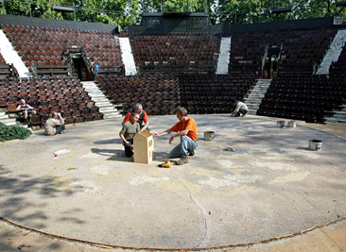
Setting the Stage
“In the round” stage is surrounded by an audience on all sides.

Slide 18
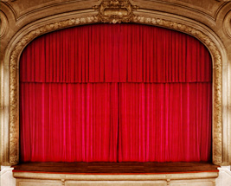
Setting the Stage
Proscenium stage
  The playing area extends behind an opening called a “proscenium arch.”
  The audience sits on one side looking into the action.
upstage
stage right
stage left
downstage

Slide 19
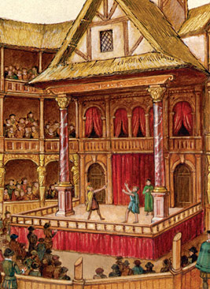
Setting the Stage
Stages in Shakespeare’s time were thrust stages.

Slide 20
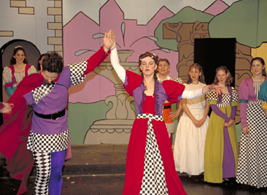
Setting the Stage
Scene design transforms a bare stage into the world of the play. Scene design consists of
  sets
  lighting
  costumes
  props

Slide 21
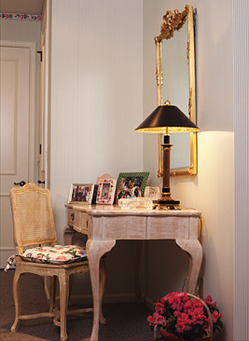
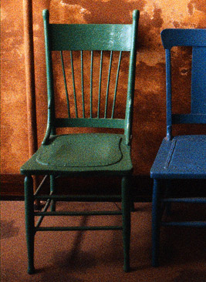
Setting the Stage
A stage’s set might be
realistic and detailed
abstract and minimal

Slide 22
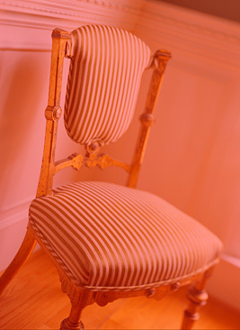
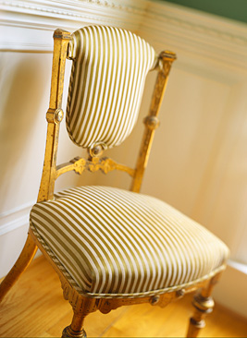
Setting the Stage
A lighting director skillfully uses light to change the mood and appearance of the set.

Slide 23
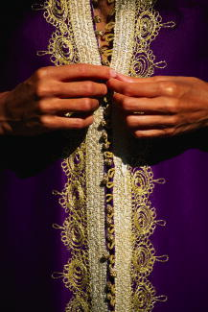
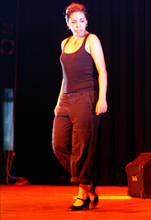
Setting the Stage
The costume director works with the director to design the actors’ costumes.
  Like sets, costumes can be
detailed
minimal

Slide 24

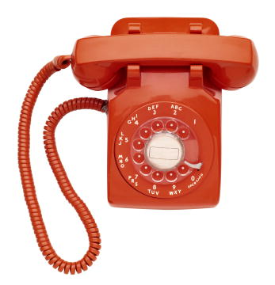
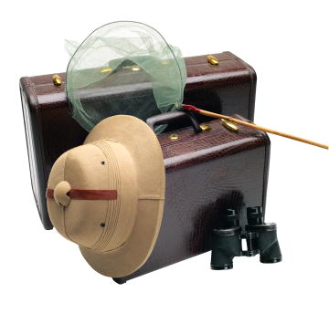

Setting the Stage
Props (short for properties) are items that the characters carry or handle onstage.
  The person in charge of props must make sure that the right props are available to the actors at the right moments.

Slide 25
The Characters
The characters’ speech may take any of the following forms.
Dialogue: conversations of characters onstage
Monologue: long speech given by one character to others
Soliloquy: speech by a character alone onstage to himself or herself or to the audience
Asides: remarks made to the audience or to one character; the other characters onstage do not hear an aside

Slide 26

The Audience
Finally, a play needs an audience to
experience the performance
understand the story
respond to the characters

Slide 27
The End

Slide 28
This powerpoint was kindly donated to www.worldofteaching.com
http://www.worldofteaching.com is home to over a thousand powerpoints submitted by teachers. This is a completely free site and requires no registration. Please visit and I hope it will help in your teaching.

